Slide 1
When to use indexing pro Features
Andy Mallon he/him

Slide 2

Andy Mallon
I sell furniture at the mall
Database Architect at Wayfair.com*
Working with SQL Server since 2003
Background in Tech Support, Database Administration, and Database Architecture
Lazy
Impatient
* The views & opinions expressed in this presentation are mine alone and do not reflect the views of my employer.

Slide 3






Notes:
Some of the things I love most in life– My husband, my pups, Queery the Diversity Dino.

Slide 4



Contact Andy
Andy@AMtwo.co
@AMtwo
am2.co/shortcuts
andy@am2.co

Slide 5

Session Feedback
Tell me what you don’t like
Tell me what can be better
Tell me what you like

Slide 6


Yea…….You apparently didn’t put one of the new coversheets on your TPS reports.
I'm also gonna need you to go ahead and silence your phones and devices

Slide 7
Agenda
Index flavors – What are they?
When to use fancy indexes?
How many indexes are enough?
This is a high-level talk…
Each of these sections could be an hour by itself.

Slide 8
But first…
All data is stored on pages
Pages are combined into different structures
B+ Trees
Clustered indexes
Nonclustered indexes
Indexed views
Heaps

Slide 9
Table Structures: B+ Trees
AK
ID
Root Page
Intermediate Level(s)
AK
CA
FL
ID
KY
ME
Leaf Pages
AK AL AR AZ
CA
CO
CT
DE
FL GA
HI
IA
ID
IL
IN
KS
KY
LA
MA
MD
ME
MI MN
MO
Notes:
These are the pages we’re talking about when we talk compression.
Only the LEAF PAGES get compressed in a B Tree Index Everything is ordered. It’s easy to find by traversing the tree. You can find any row in just 3 reads. EXAMPLE: MAINE

Slide 10
Table Structures: Heaps
MA MN IL KY
AR
CO
MI
DE
IN GA
HI
AZ
ID
CT
MD
KS
IA
LA
MO
CA
ME
AK AL
FL
Notes:
It’s unordered. It’s harder to find the row you want. But for our purposes today, it’s similar to the leaf level of a B-Tree

Slide 11
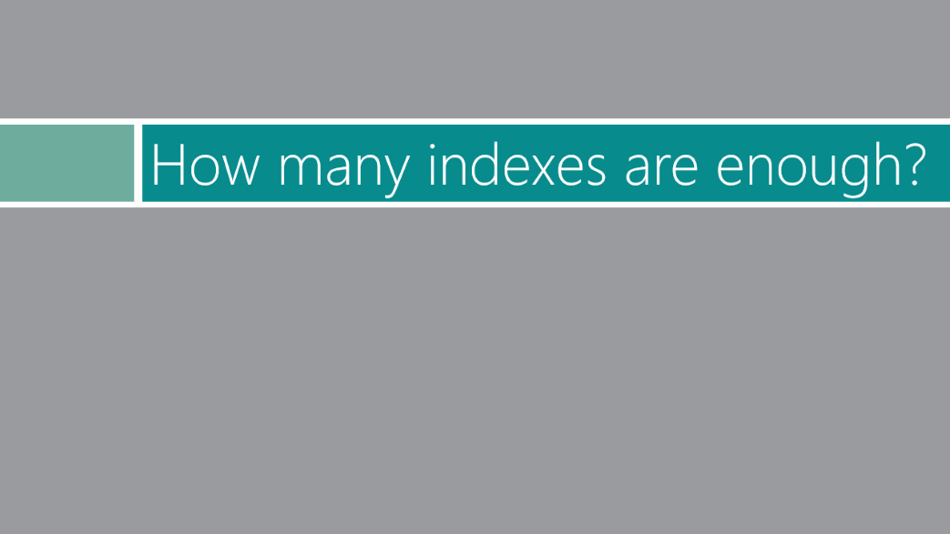
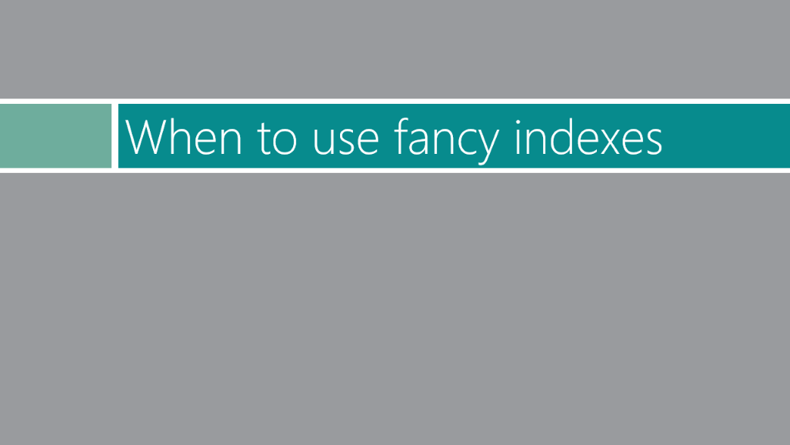


Slide 12
Index Flavors

Slide 13
Clustered vs Nonclustered
Clustered Index
Nonclustered index
This is the row data
Ordered by the key columns
All the columns
Except if it’s over 8kb
LOB data & wide tables use off-row data
The columns explicitly listed in the key or include clause
Plus the clustering key
Or the RID if it’s a heap
Ordered by the key columns
Maximum key size is 1700b

Slide 14

Filtered indexes
A non-clustered index with a WHERE clause
Filters specific rows
https://amzn.to/2mLajwX

Slide 15
Filtered Indexes
Use equality/inequality operators
=, <>, <, >, <=, >=, IS NULL, IS NOT NULL, IN(…)
Cannot use BETWEEN or NOT IN
Must be deterministic
Example: not based on GETDATE()

Slide 16
Filtered Index Sample
CREATE INDEX ix_QueueStatus
ON dbo.WidgetQueue (QueueStatus)
WHERE QueueStatus = 'S';

Slide 17

Compressed indexes
A different method of storing data on disk and in memory
More efficient use of space
Requires slightly more CPU to read/write data
https://amzn.to/2nmseKV

Slide 18
Index Compression types
ROW
PAGE
Applied to each individual row
Usually makes a row occupy fewer bytes
Smaller rows → More rows per page
Applies row compression first
Then prefix compression
Then dictionary compression
Essentially dedupes data within the page
Notes:
Notice I say USUALLY takes less space. It’s that whole “It Depends” thing. More on that later

Slide 19
Compression Sample
CREATE INDEX ix_QueueStatus
ON dbo.WidgetQueue (QueueStatus)
WITH (DATA_COMPRESSION = PAGE);

Slide 20
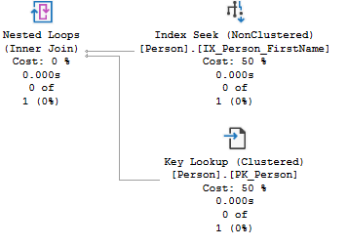
Included Columns
Extra columns in the index, not part of the key
Can be data types not allowed as key columns
Not considered when calculating size limitations
Avoids key/RID lookups

Slide 21
Included Column Sample
CREATE INDEX ix_QueueStatus
ON dbo.WidgetQueue (QueueStatus)
INCLUDE (ExternalID);

Slide 22

Columnstore Indexes
Physically stored in a column-wise data format
High compression rates for large data sets with repeated values
Turns storage 90 degrees
Primarily accesses data by columns, rather than by rows
https://amzn.to/2lbcUQj

Slide 23
Columnstore Sample
CREATE CLUSTERED COLUMNSTORE INDEX cci ON dbo.ReallyBigTable;
CREATE NONCLUSTERED COLUMNSTORE INDEX ncci ON dbo.ReallyBigTable (ProductID, CustomerID, Amount);

Slide 24
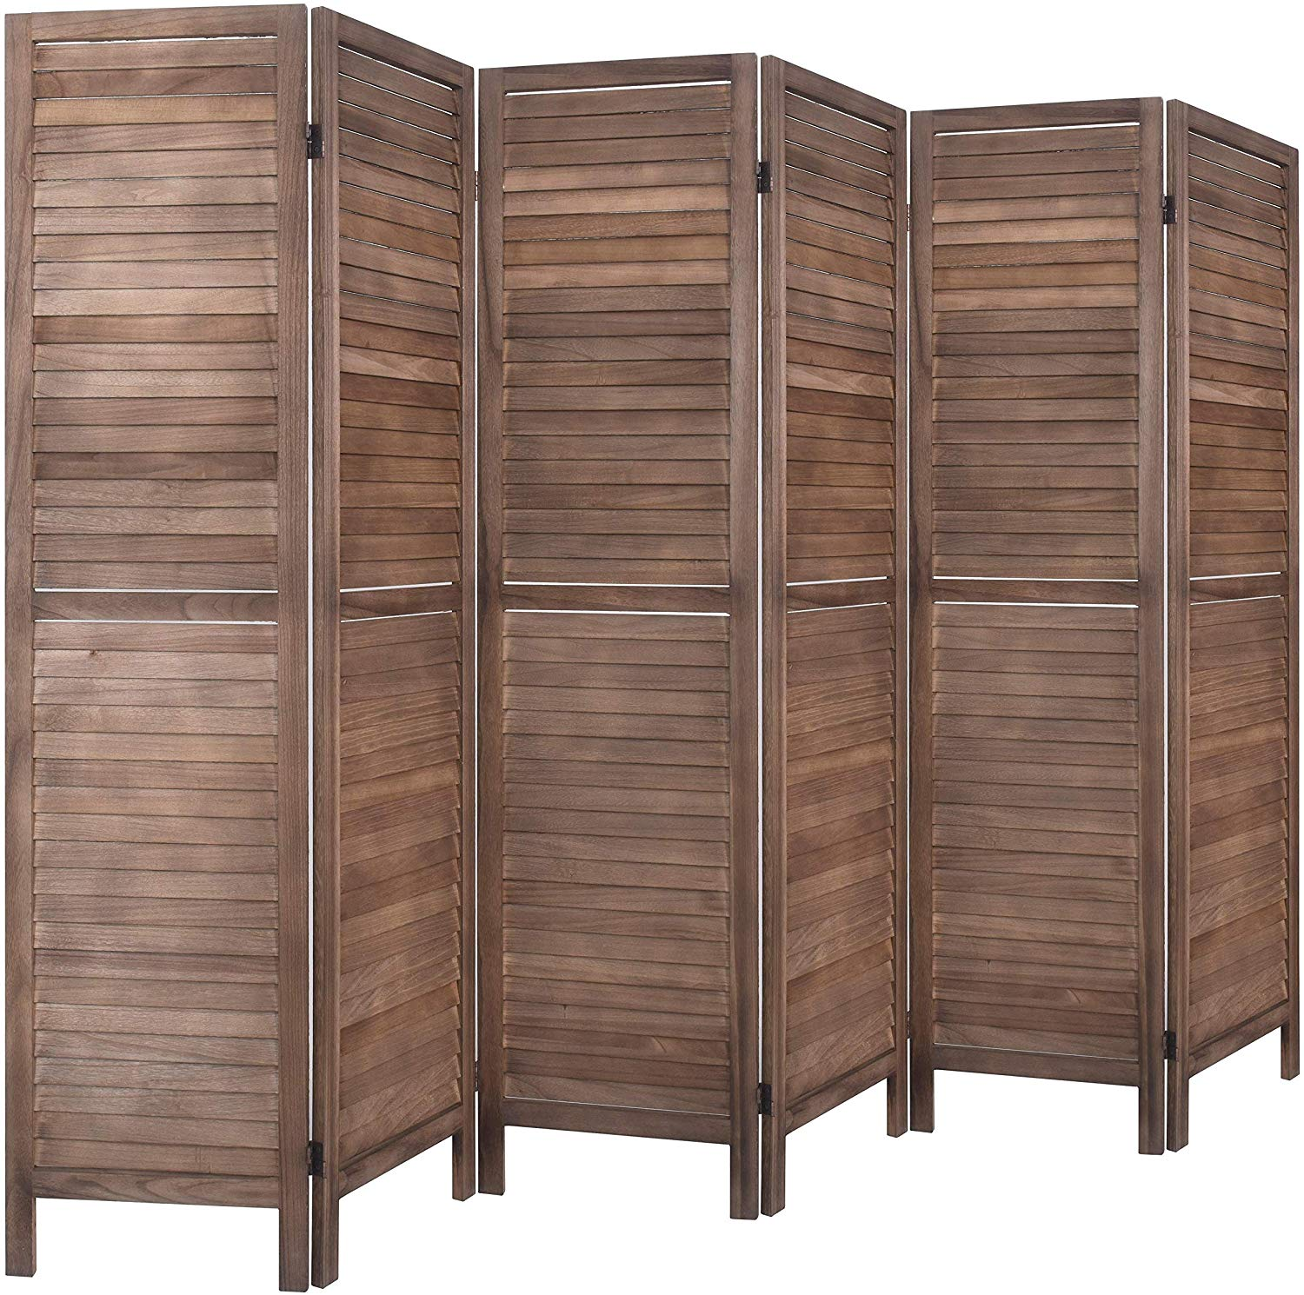
Partitioning
Breaks up a table into multiple B-Trees
A management feature for large tables
Not a performance feature
https://amzn.to/2lNH8ZW

Slide 25
When to use fancy indexes

Slide 26
Filtered Indexes
Queues & status processing are great use cases
Queries cannot use the index is the index filter uses a variable or parameter in the predicate
WHERE status = 'a'
WHERE status = @status
WHERE status IN ('a','b','c')
AND status = @status

Slide 27
Compression Costs & Benefits
Pros
Cons
Less space on disk
This benefit multiplies each time you copy data to a different environment
More rows per page on disk
Fewer physical IO operations
More rows per page in memory
Cache more data in memory
Fewer logical IO operations
Small CPU overhead associated with compression
Is CPU already a bottleneck?
Overall CPU impact likely minimal
Data needs to decompressed every time you read a page from memory
Enterprise Edition feature (until 2016)
$$$$
Impacts database portability
Notes:
Because it’s the SAME PAGE on memory & on disk, these two bullets are really saying the same thing No longer Enterprise only if (only if) you are on 2016 SP1+ The list of cons is pretty short.

Slide 28
When ROW compression can’t compress
Variable-length data
Varchar
Varbinary
LOB data types
XML
n/varchar(max)
Fixed-length data that uses full length
UNIQUEIDENTIFIER
DATE or TIME
CHAR(10) that actually contains 10 characters

Slide 29
When PAGE compression can’t compress
Rows with highly unique data
LOB data types
XML
n/varchar(max)
It also WON’T compress if the savings isn’t significant
“I can make more room, but not enough to fit extra rows. Never mind”
It still tries every time it writes the page, burning CPU

Slide 30
Columnstore Index usage
The preferred data storage format for data warehousing and analytics workloads
Non-clustered columnstore indexes can be added to OLTP databases
“Real time operational analytics” 🐝🐝

Slide 31
Partitioning
Not a performance feature
Ok, Partition Elimination can help performance
Data management feature
Partition swapping
Truncating or dropping a partition
Piecemeal restores

Slide 32
How many indexes are enough?

Slide 33

Not an easy answer
Slow inserts aren’t usually a problem
Index & Stats maintenance will take longer with more indexes
Maximum of 999 nonclustered indexes on a table
Limitations are not goals

Slide 34
Filtered indexes
https://www.sqlpassion.at/archive/2018/11/05/filtered-indexes-in-sql-server/
Compressed indexes
https://am2.co/category/data-compression/
Columnstore
http://www.nikoport.com/columnstore/
Partitioning
https://www.cathrinewilhelmsen.net/2015/04/12/table-partitioning-in-sql-server/

